Slide 1
Image Denoising Guided By : Prof. Shanmuganathan Raman
Patch Group Based Nonlocal Self-Similarity Prior Learning

Slide 2
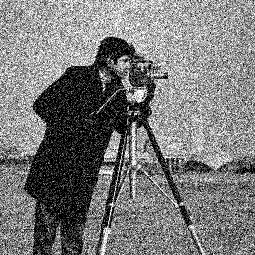
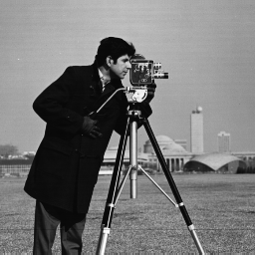

Slide 3
Idea ?
Super Resolution from single image by Daniel Glasner ,Shai Bagon and Michal Irani
As super resolution could be obtained by :
The classical multi-image super-resolution i.e. combining images obtained at subpixel misalignments
Example-Based super-resolution learning correspondence between low and high resolution image patches from a database

Slide 4
Idea ?
Obtained SR from a single low-resolution image without any additional external information
Basis was that patches in a single natural image tend to redundantly recur many times inside the image, both within the same scale, as well as across different scales
Used Image pyramid Concept

Slide 5
Image Pyramid
type of multi-scale signal representation in which an image is subject to repeated smoothing and subsampling
Two types : lowpass and bandpass
Used lowapss : made by smoothing the image with an appropriate smoothing filter and then subsampling the smoothed image
Used Gaussian pyramid : images are weighted down using a Gaussian average (Gaussian blur) and scaled down

Slide 6
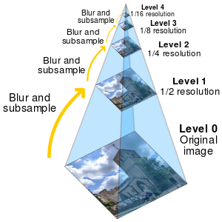

Slide 7
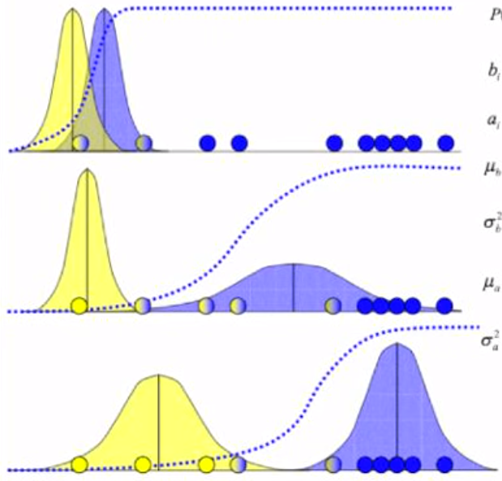
GMM Algorithm (Soft Clustering)
Stands for Gaussian Mixture Model
Unsupervised learning clustering algorithm
Find P(Xi/b) then find P(b/Xi) = b taking
Gaussian distribution function
Same as K-mean clustering but difference
Is of weightage.
We give weightage that what are the chances
that any point belong to which distribution

Slide 8

Gaussian Distribution Function
= P(Xi/b)

Slide 9
GMM Algorithm
Start with initial guess of parameters (mu and sigma)
E step : estimate membership given parameters
M step : estimate parameters given membership
Repeat until convergence
Approximate min or max

Slide 10

Weighted Sparse Coding
For each patch in the PG , use D as the dictionary to sparsely encode Xm as Xm = Dα + v, where α is the vector of sparse coding coefficients and v is the corrupted noise. Meanwhile, we propose to introduce a weighting vector w to weight the coding vector α
We used one norm to change problem from NP hard to simple problem
By Maximum A-Posterior (MAP) estimation, we find the optimal solution for alpha

Slide 11
Sequence of Denoising
Took one blurred image
Created Image pyramid using Gaussian pyramid of noisy image
PGs are extracted from training images by putting nonlocal similar patches into groups, and algorithm is developed to learn the NSS(non local self similarity ) prior by using the fact that a local patch often has many nonlocal similar patches to it across the image
Trained Dictionary using the images formed from pyramid PG-GMM model
weighted sparse coding model used which has a closed-form solution used to perform image denoising

Slide 12
Image Denoising
aims to recover the clean image x from its noisy observation y = x + v,where v is assumed to be additive white Gaussian noise
approach is to model the image priors on patches and forming patch group by grouping the similar patches to a local patch in a large enough neighborhood
used Gaussian Mixture Model (GMM) to model image patches, and achieved denoising
sparse representation based scheme which encodes an image patch as a linear combination of a few atoms selected from a dictionary
The dictionary has been trained using K-SVD algorithm uses learning from noisy image

Slide 13
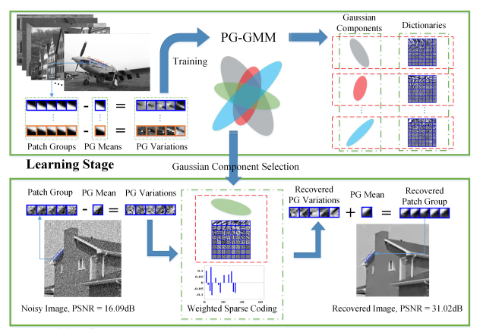

Slide 14
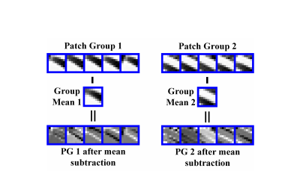
Procedure
Given a noisy image y for each local patches we find
similar patches in a window centered on it to form a
Patch group
group mean of Y, denoted by µy, is calculated and
subtracted from each patch shown here.

Slide 15
From subtracted PG, select the most suitable Gaussian component to it from the trained PG-GMM
Done by checking the posterior probability(E-M steps iteratively) of which image patch belongs to the which Gaussian component
Done using taking log likelihood and GMM algorithm
Now we train our Dictionary using K-SVD algorithm
Finally denoising by using weighted sparse coding

Slide 16
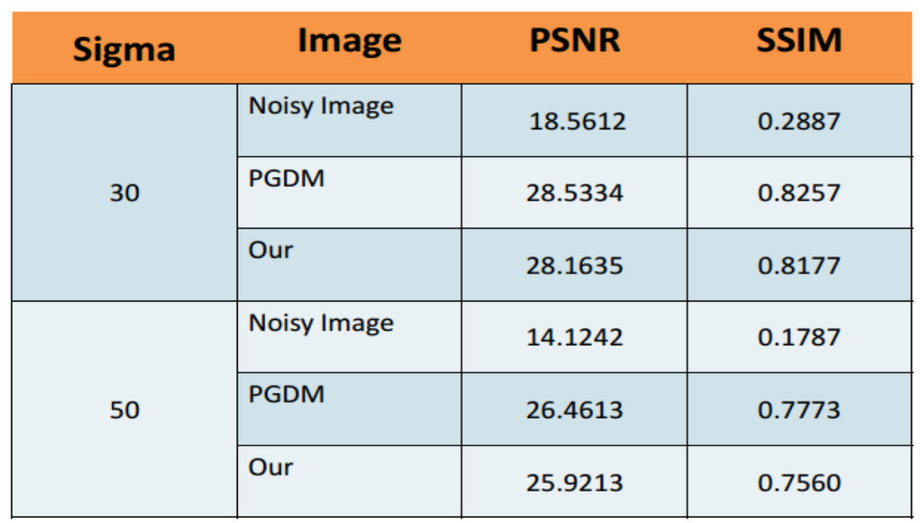
Comparison of Peak to noise ratio and Structural Similarity

Slide 18
Pros and Cons
Requires only one image the noisy image only no need of extra image to train the dictionary
Method takes very less time to train the dictionary relative to other denoising model
mean vector of each Gaussian component in PG-GMM is naturally a zero vector so , we only need to learn the covariance matrix of each component without considering its mean
PSNR (peak to noise ratio ) is slightly less that some current developed method but also better than traditional methods used earlier

Slide 19
References
http://www4.comp.polyu.edu.hk/~cslzhang/paper/PGPD.pdf
http://www.wisdom.weizmann.ac.il/~vision/SingleImageSR.html
http://www.wisdom.weizmann.ac.il/~/irani/
https://www.youtube.com/watch?v=y8wk0VVEaiY
https://www.youtube.com/watch?v=XLXSVLKZE7U
https://www.youtube.com/watch?v=h_fYIs0hdL0
https://www.youtube.com/watch?v=eq-itFq0Sco

Slide 20
Thank You

